Slide 1
The Berkeley Networks of Workstations (NOW) Project
By: Thomas E. Anderson, David E, Culler, David A. Patterson Computer Sciences Division/EECS Department University of California at Berkeley Berkeley, CA 94720 USA
http://now.cs.berkeIey.edu
Background of Computing in 1995
What was the Berkeley project?
What was the Motivation for the research?
How does it relate to previous work?
What are the most important points made in the paper?
What specific examples or ideas used in the paper?
What future work is indicated in the paper?

Slide 2
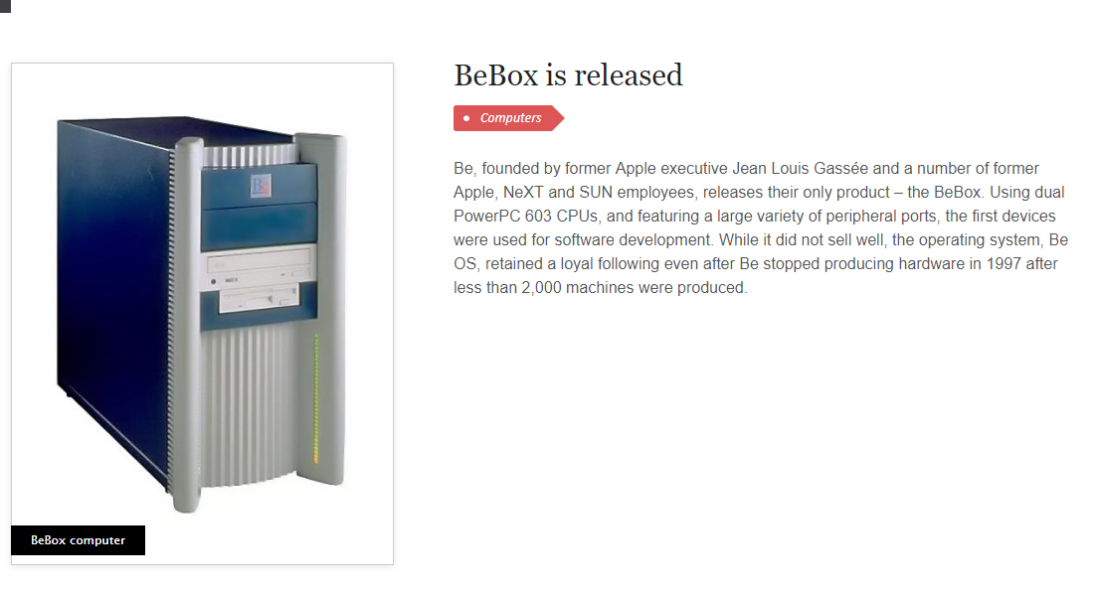

Slide 3
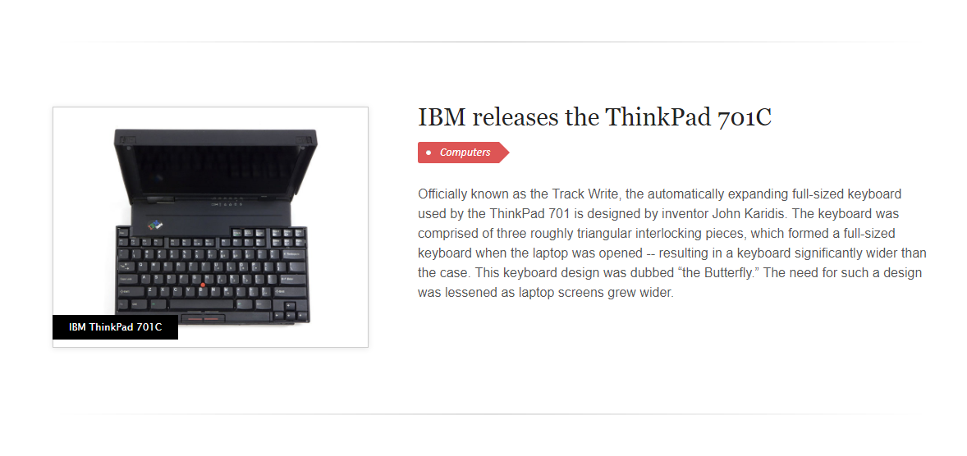
https://www.youtube.com/watch?v=SLj3aCfqzOM
Notes:
https://www.youtube.com/watch?v=SLj3aCfqzOM

Slide 4
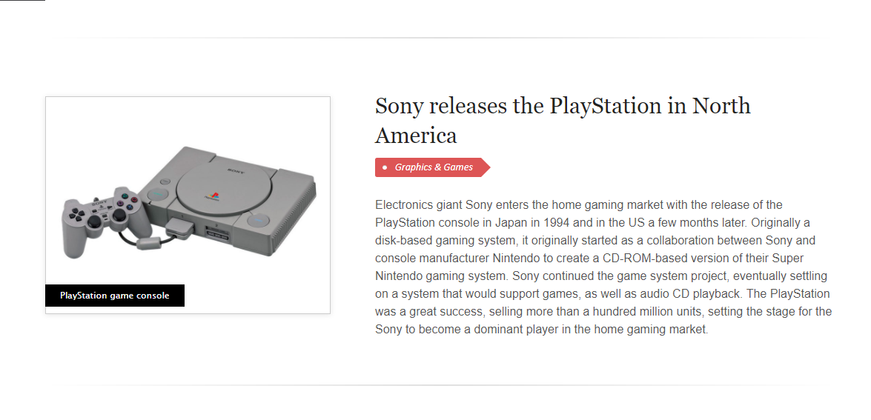

Slide 5
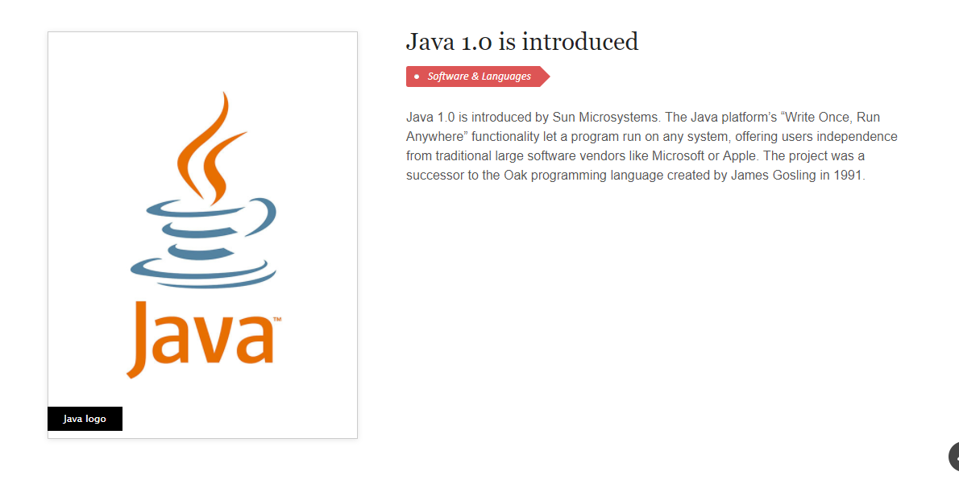

Slide 6
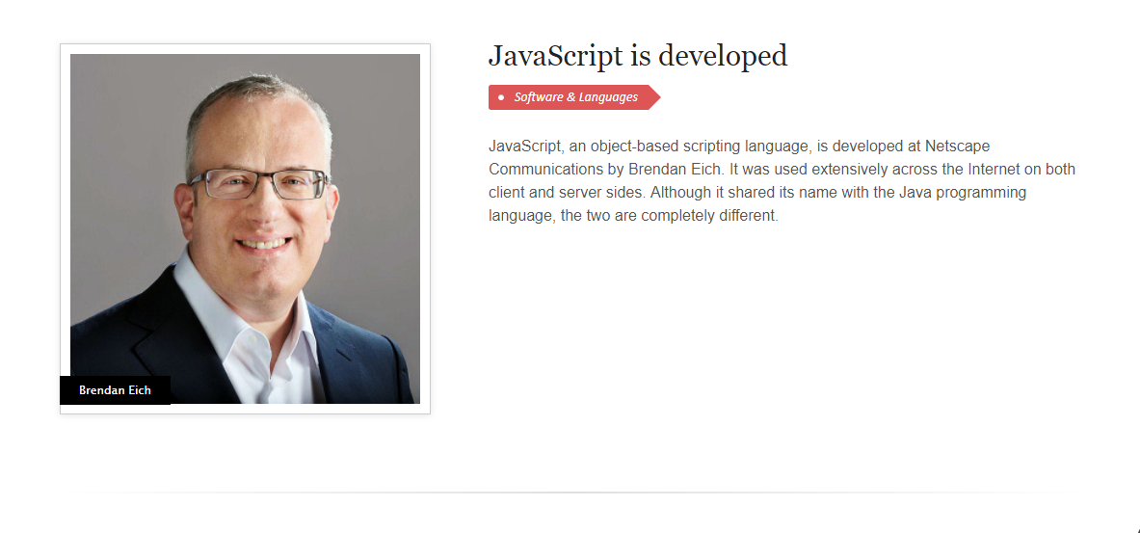

Slide 7
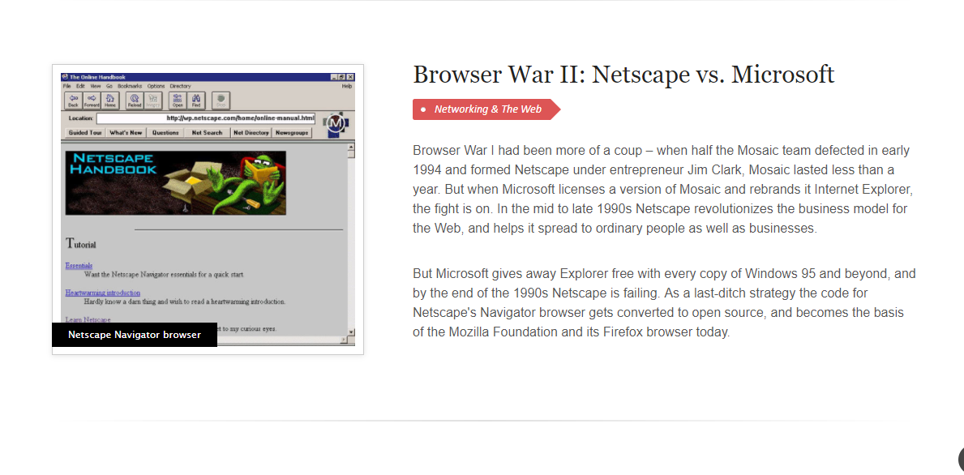

Slide 8
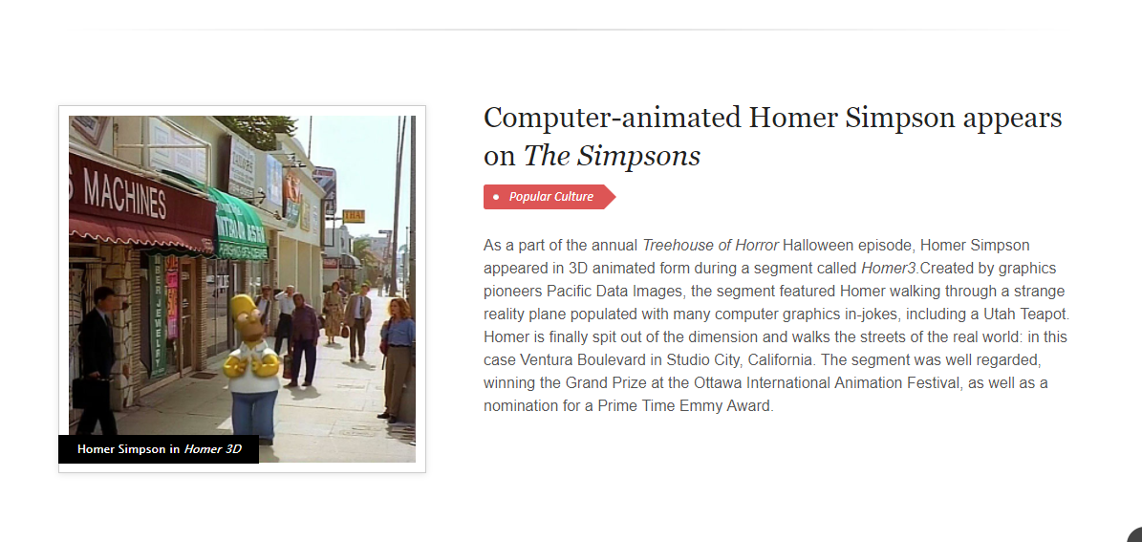

Slide 9
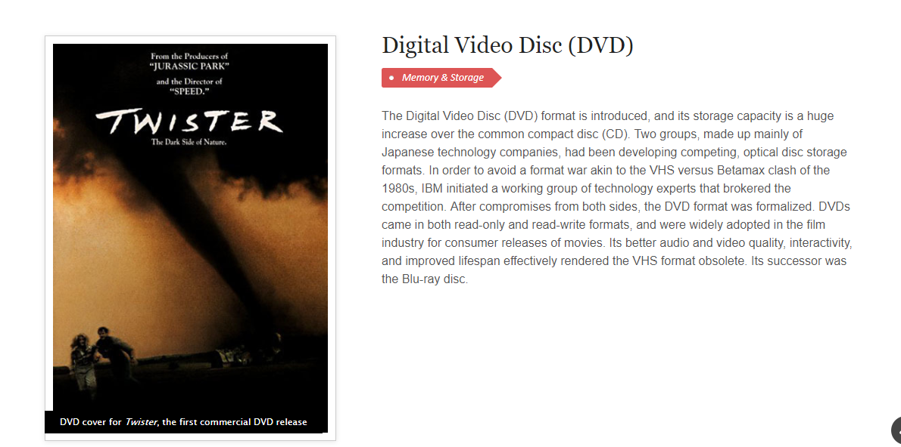
Notes:
Introduction, Good Morning Everyone etc. Reporting on Berkely NOW paper. Point out 1995 HARD READ I broke the paper down into… On the slide I have the break down of how I will present this. Slide 1. 1995 Context The History of Computing in 1995. Famous OS, Computers Available, Linux Version, Brands (Packard Bell) Clarifying Differences between Workstation and Servers. What was the Berkeley project?
What was the Motivation for the research? How does it relate to previous work? What are the most important points made in the paper? What specific examples or ideas used in the paper?
What future work is indicated in the paper?

Slide 10
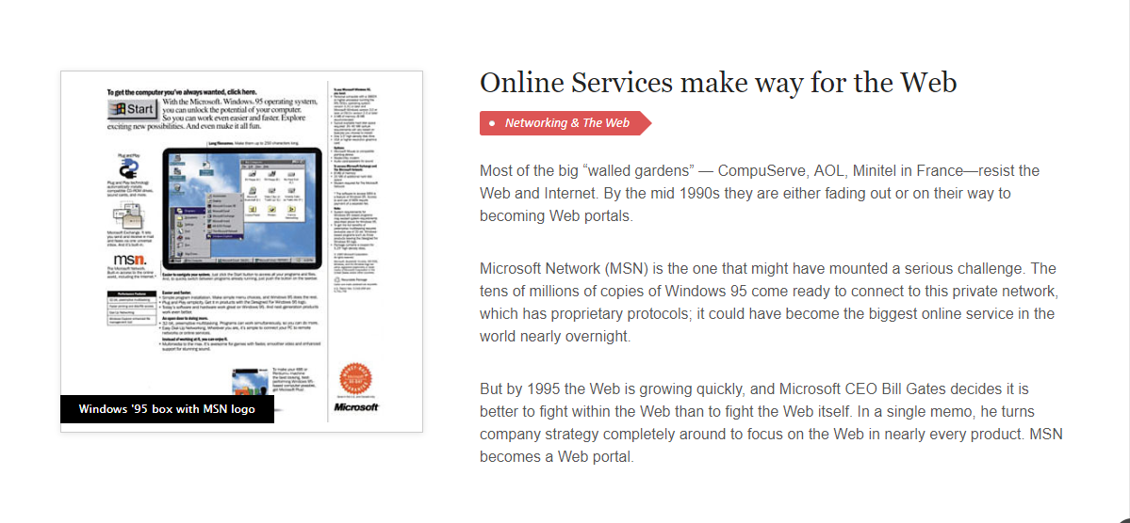

Slide 11
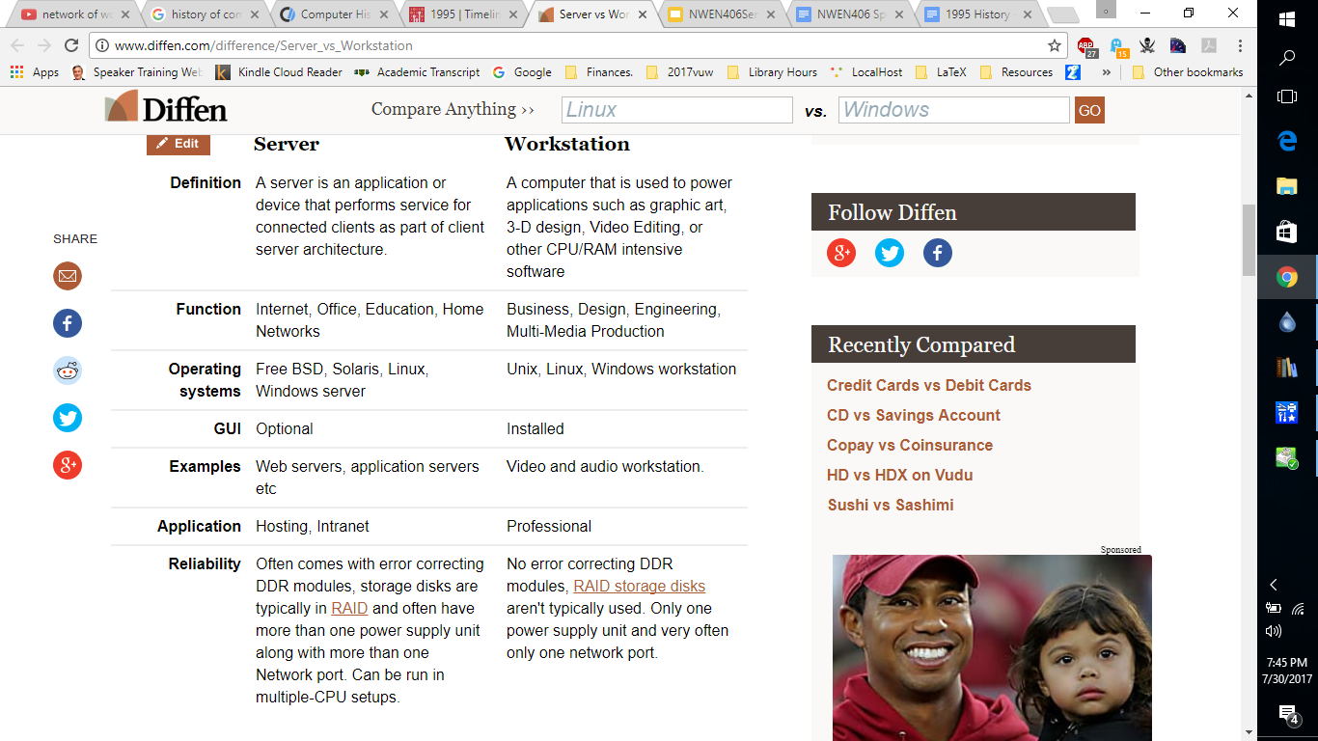
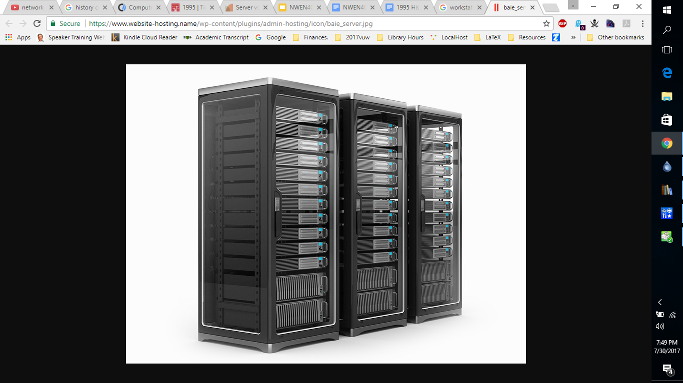
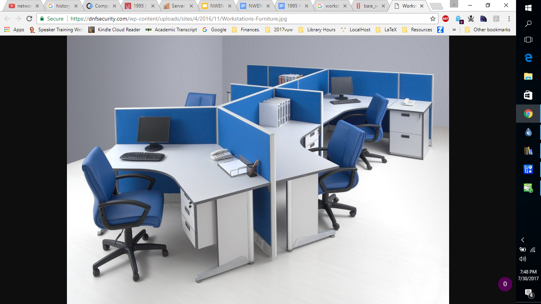

Slide 12
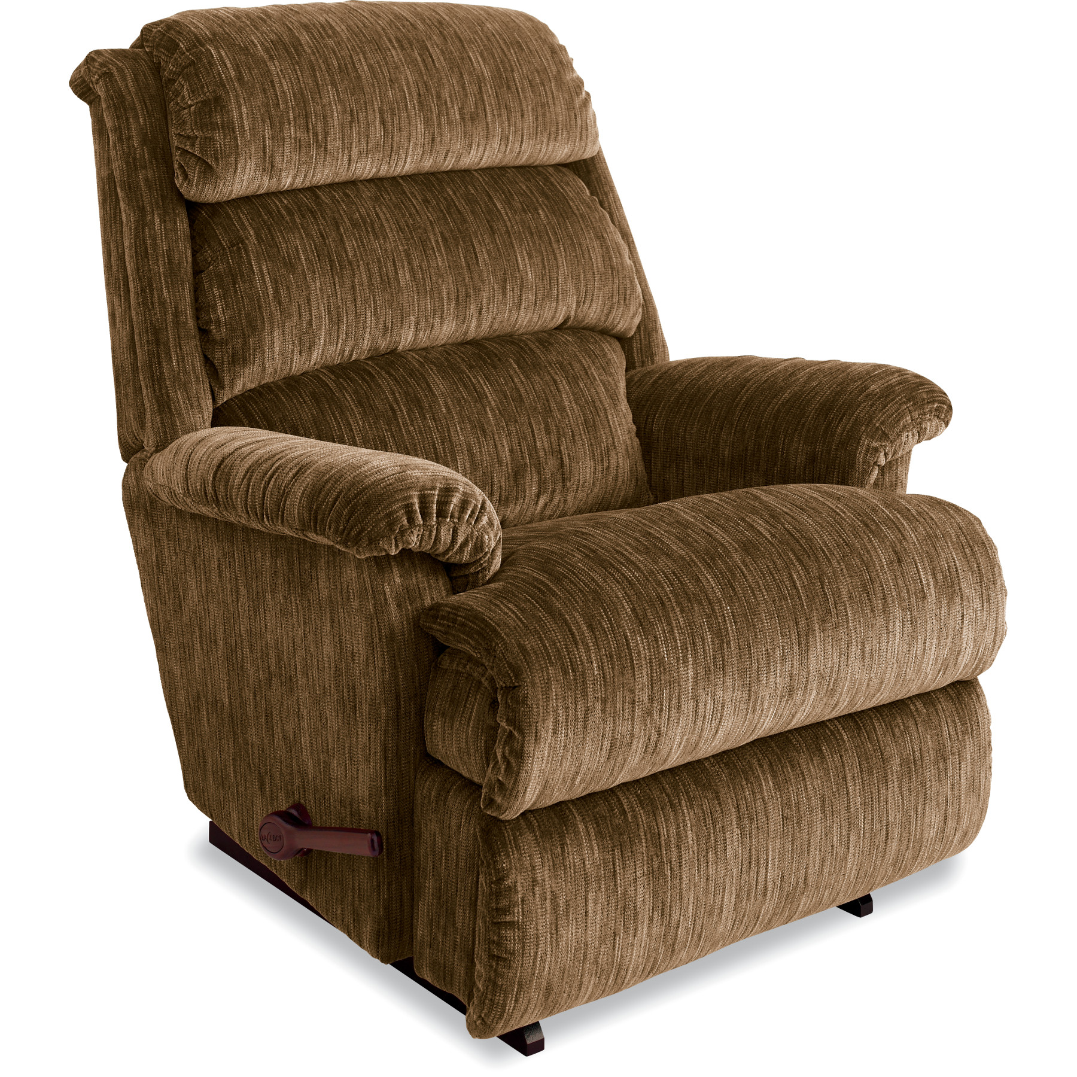
What was the Motivation for the research? Lazy Boy Chair. If you want to make you program run fast you will need to figure out how to do it with multiple processors. The motivation is identifying the pioneering research in how this was done. In 2 years time I will need more processors for a faster device.

Slide 13
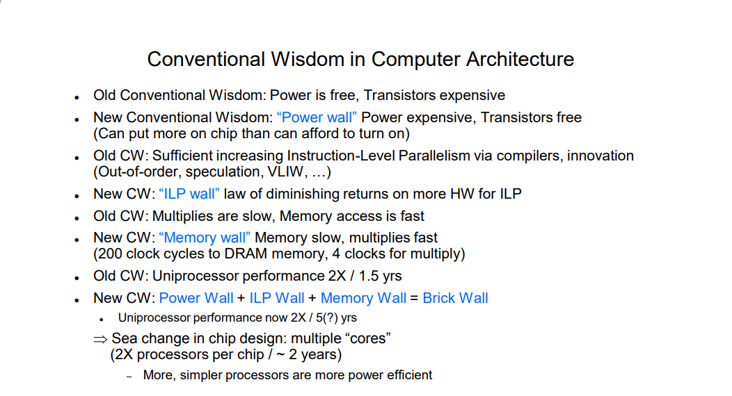
Paper Motivation (2007)
https://www.youtube.com/watch?v=On-k-E5HpcQ

Slide 14
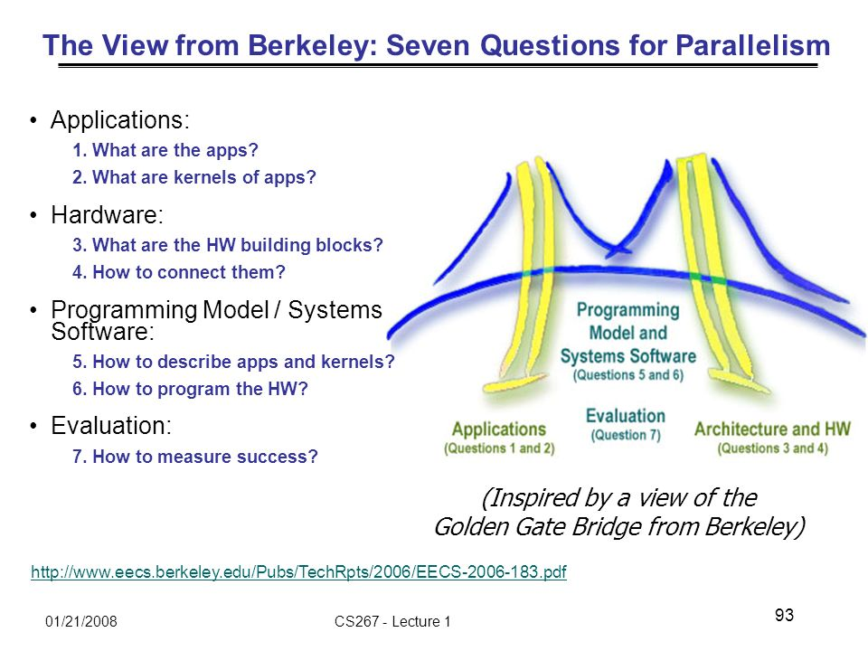

Slide 15
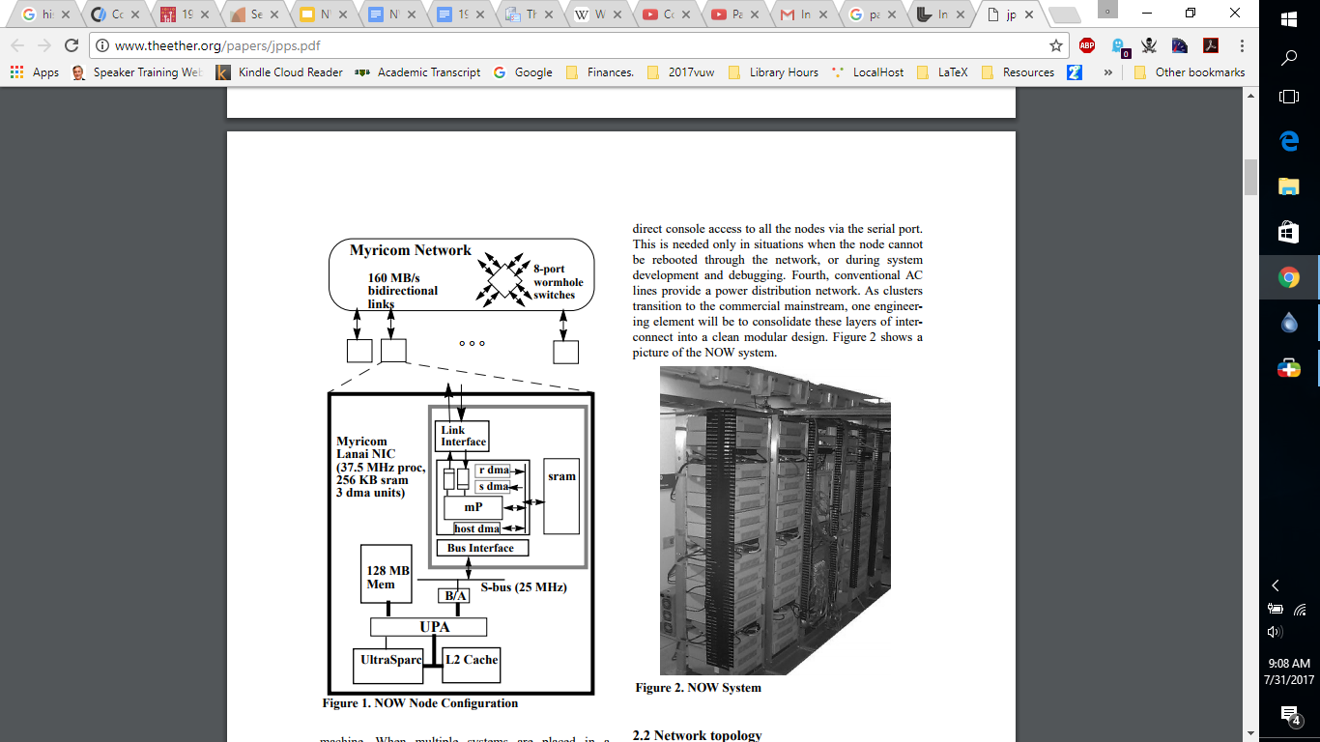
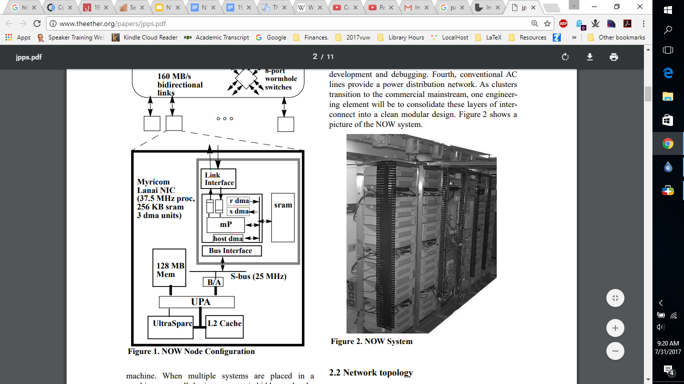
Berkeley NOW System HardWare Configuration
One hundred and five Sun Ultra 170 workstations, connected by a large Myricom network,
and packaged into 19-inch racks. Each
workstation contains a 167 MHz Ultra1 microprocessor
with 512 KB level-2 cache, 128 MB of memory, two 2.3
GB disks, ethernet, and a Myricom “Lanai” network
interface card (NIC) on the SBus. The NIC has a 37.5
MHz embedded processor and three DMA engines,
which compete for bandwidth to 256 KB of embedded
SRAM. The node architecture is shown in Figure 1.

Slide 16
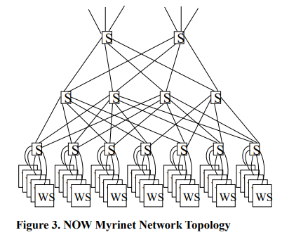
Network Topology
The Myrinet switches that form the high-speed interconnect.
The topology is constrained by the use of 8-port switches and wiring density concerns.
Groups of seven of these switches are treated as a 35-node subcluster with the 21 upward links spread over four level-two switches.
Three of these subclusters are wired together to comprise the NOW.

Slide 17
Software Architecture
The system software for NOW employs a layered architecture, as illustrated in Figure 4. Each node runs a complete, independent Solaris Unix with the associated
process management, memory management, file system,
thread support, scheduler, and device drivers. We extend
Solaris at each of these interfaces to support global
operations over the NOW.
Process Management
# glush OR # glush-run
File System
Files are striped over nodes in a RAID-like fashion so that each node can read file data at the bandwidth of its interface into the network.
Virtual Memory
Allows paging to remote nodes through deamons.

Slide 18
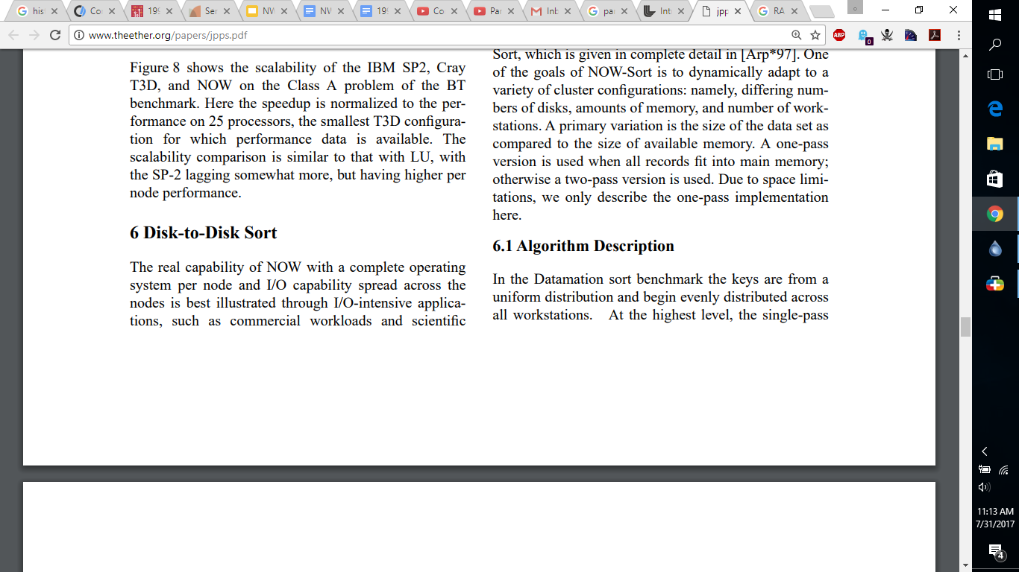
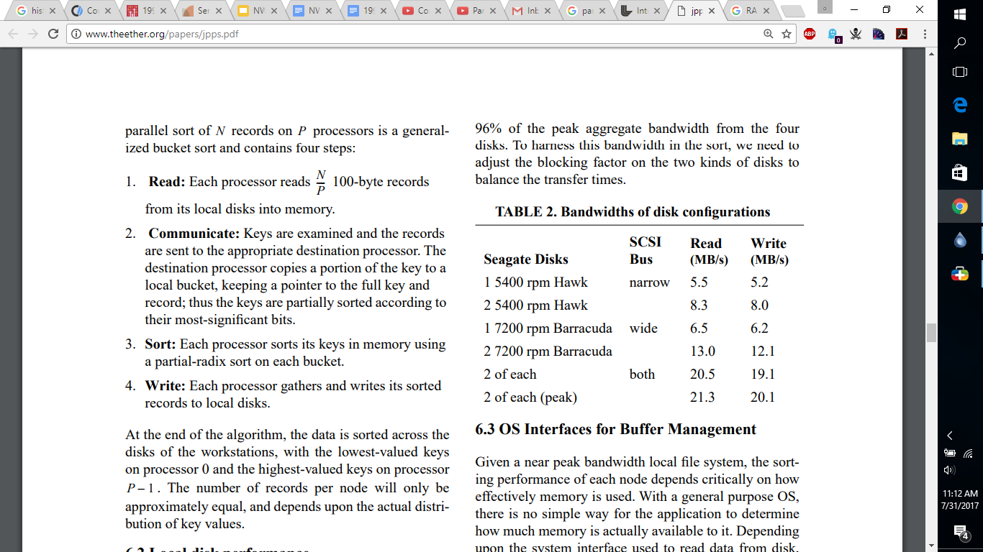

Slide 19
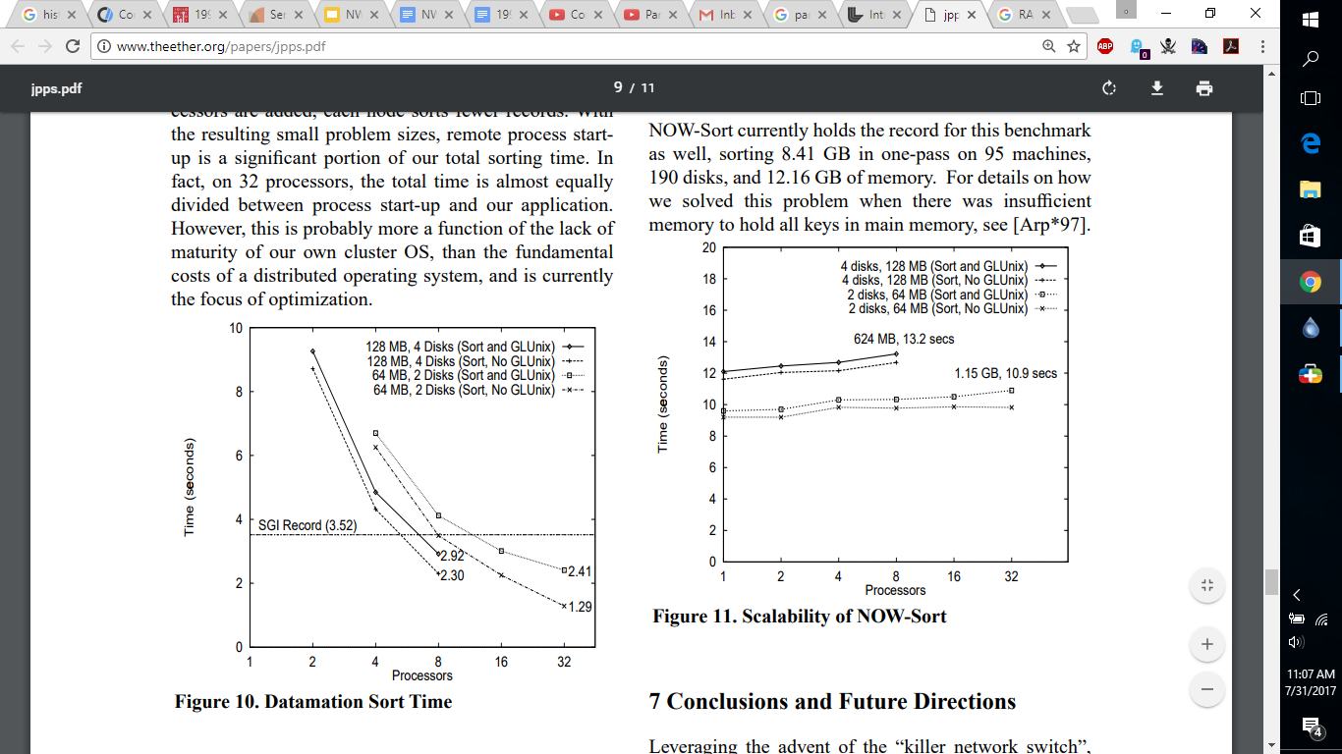
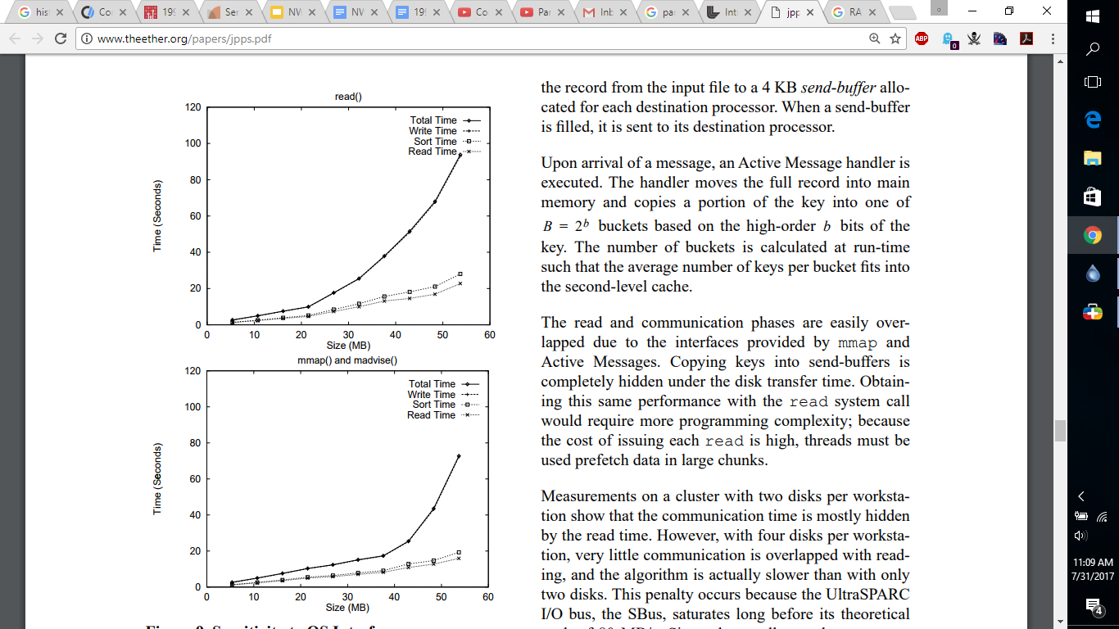

Slide 20
What the Now System Achieved The infrastructure necessary for running parallel applications has been thoroughly exercised in our system. We have shown that not only can we obtain the low-latency, high-bandwidth communication traditionally seen in only tightly-integrated MPP systems, but also that this
communication performance directly corresponds to speedups for scientific parallel applications. Through disk-to-disk sorting, we have demonstrated many of the strengths of the NOW approach: the presence of a complete OS and file-system on each node for memory management and high-performance I/O, and the ability to isolate performance issues.

Slide 21
Future Work/ Ideas. Assembling the more than 100 Sun UltraSparc workstations in our current configuration raised a number of unique engineering issues, such as cable management, boot and diagnostic support, and system administration, but reasonable solutions exist for each. Thanks ! - Questions?

